Slide 1
School 13
Virtual Open House
October 7, 2020
Related Service
Speech-Language Therapy

Slide 2
Agenda for Open House
6:00 Open House Start Time
6:00-6:30 Administration Introductions and Message
6:45-7:15 Teacher Presentations on Teams
7:30-8:00 Teacher Presentations on Teams for Parents of Multiple Students
Special Area Teachers Power Point for Parent Viewing on Teacher Home Page and/or Class Dojo

Slide 3
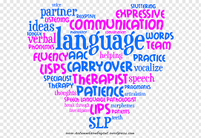
Welcome to
Speech-Language Therapy at
School 13 with
Ms. Augustine

Slide 4
About the
Speech-Language Pathologists
Ms. Augustine is a speech-language pathologist working in the Yonkers Public Schools for over thirty years. I have had the pleasure and opportunity to work with students at School 13 for over thirty-three years.
I, Ms. Augustine hold a NYS license in speech-language pathology and is nationally certified by the American Speech-Language-Hearing Association (ASHA).
I am also certified as a NYS Teacher of the Speech and Hearing Handicap.

Slide 5

Classroom Expectations
Students are expected to :
  Be on time
  Be ready to learn
  Be respectful and use kind words
  Follow directions
  Participate during the sessions
  Take turns
  Try their best
  Work on and complete all assignments

Slide 6
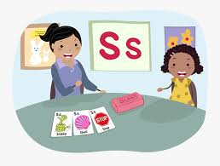
How speech-language therapy helps your child in school
Depending on the student’s IEP, speech-language services can be provided individually and/or in a small group setting and may focus on one or more of the following areas:
Receptive and Expressive Language (verbal and written)
  Building vocabulary skills (context clues, synonyms/antonyms, multiple meaning words, linguistic concepts, categorization, parts of speech, etc.)
  Asking and answering various question forms (Wh?s, inferencing skills) literal/concrete questions to more abstract, higher level forms
  Sentence formation (improving structure and expanding language usage)
  Processing skills including following directions (multi-step directions, complex, etc.) and sequencing.
  Understanding figurative language (idioms, metaphors, similes, etc.)

Slide 7

How speech-language therapy helps your child in school
(continued)
Literacy Skills
  Phonemic and phonological awareness activities (e.g. sound discrimination, sound manipulation, rhyming)
  Reading Comprehension skills
  Narrative/ story retell
Articulation
  Improving sound productions and speech intelligibility
Fluency/Stuttering
  Strategies to improve a student’s speech fluency when expressing their thoughts and ideas verbally

Slide 8
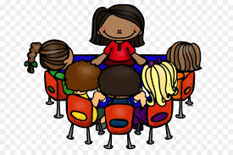
How speech-language therapy helps your child in school
(continued)
Pragmatic/Social language
  Help students learn the rules of conversation and social interactions
Collaborate with classroom teachers to best support the student’s speech-language needs in the classroom (testing accommodations, program modifications).

Slide 9

Contact information
If you have any questions or would like to discuss your child’s individual goals, we can best be reached in the following ways:
Ms. Augustine can be reached by email: jaugustine@yonkerspublicschools.org or by sending a message through her Class Dojo page: Ms. Augustine’s Class 2020-2021
Additionally, I can be reached via Microsoft Teams or by calling the School 13 (914)376-8335 and leaving a message. I will respond to your call as soon as possible.

Slide 10

Success in
Speech-Language Therapy!
I am excited for a successful 2020-2021 school year of learning with you and your child!
We are a speech team!

